Slide 1
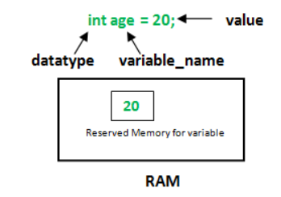
What is a Variable
Variables are containers for storing data values

Slide 2
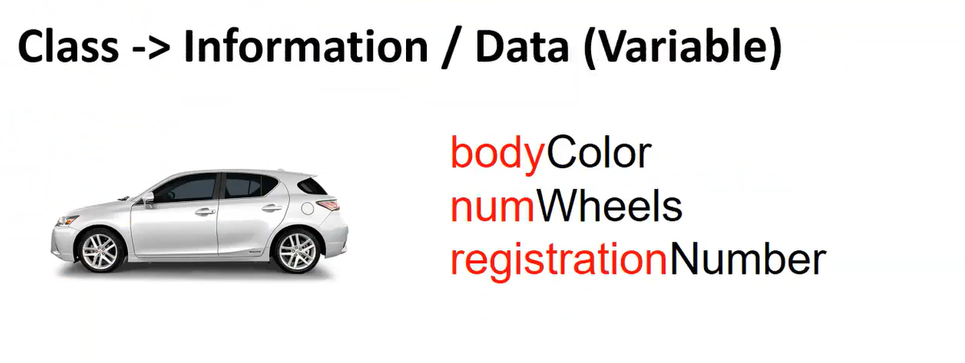
Examples
Bodycolor – String
numWheel – Integer
registrationNumber – AlphaNumeric or String

Slide 3
Types Of Variables
Static
Instance
Local

Slide 4


Explanation
Int noOfSqFeets = 1100
String builderName = “Ruby”
Int noOfrooms = 3
Actual Building – Object 1
Instance variables
Int noOfSqFeets = 800
Blue Print
String builderName = “Ruby”
Int noOfrooms = 2
Actual Building – Object 2

Slide 5


Difference between Instance and Local variables
Analogy:
Consider in the same apartment, the swimming pool and Gym will be known to all the owners
Consider in the same apartment within your house, things will not be known to others. It is only known to you

Slide 6
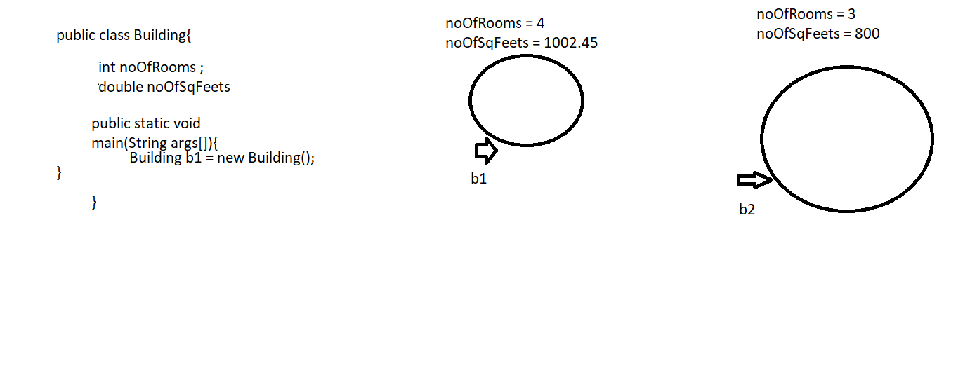
Instance Variables or Global Variables
Any variable declared inside a class but outside the method is called Instance variables
A Separate copy of values or separate memory space will be created for every object that is being created for a class

Slide 7
Local Variables
Any variable which is declared inside any method or any blocks are called Local variables
Initialization is mandatory for Local variables

Slide 8
Local Variables
Any Variables declared within a method is called Local variables
Local variables should be initialized with a value
Local variables are visible only within that method
No mandatory for Instance variable to be initialized
Create two methods inside Car class – driveCar() and applyBrake()
driveCar() – Local variable - > int kmDriven = 450;

Slide 9
Instance variables vs Local variables
Create a class called “Student”
Inside student, declare variables like Emp id, Stud name and Age as instance variables
Inside a method called study()
create a local variable called language (Pass as a parameter)
Create a local variable inside method called “complexityLevel” ;
Difference between initializing and non initializing
Which needs to be initialized and which don’t needs to be initialized
Explain high level about constructor for initializing the value

Slide 10
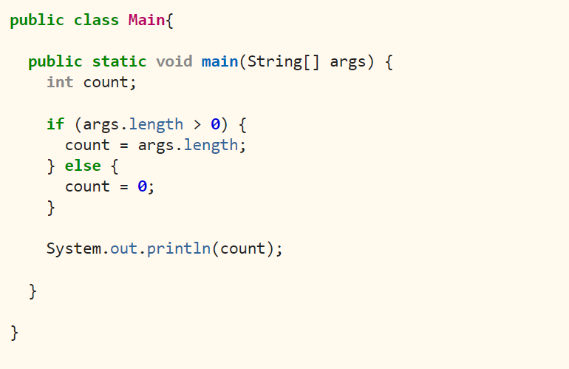
Scenario based on if-Else
Will this throw any error?

Slide 11
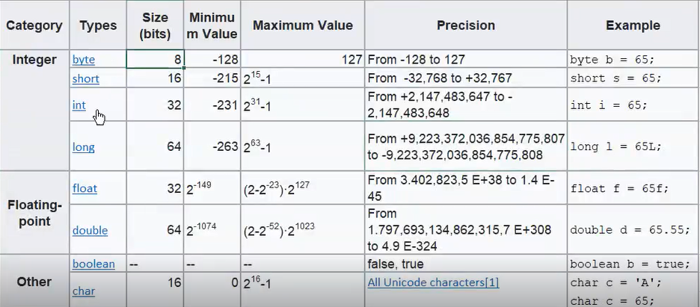
Data types

Slide 12
Types
Primitive
Non – Primitive
Primitive:
Char,byte,short, Int,long,double,float,Boolean
There is a defined range as specified in the previous slides. Memory space will be decided at compile time itself
Non – Primitive:
String, Arrays and All Objects
No defined range (No memory space). Memory space will be decided at the run time

Slide 13
Demo program on Instance variable and Data types
public class Car
{
long ownerPhNo = 34567890987L;
float fuelCapacity = 35.5f;
boolean isPuncture = false;
char fuelType = ‘P’;
double carPrice = 799999.78;
String carColor = “Red”;
Public static void main(String args[])
{
Car c = new Car();
System.out.println(c.ownerPhNo);
}

Slide 14
Home Work
1. Create a Java class called Student.
Inside that class, create instance variables which are applicable for that class.
Create a local variable and find what error if it is not initialized
2. Write a Java program to print the area and perimeter of a circle. Test Data: Radius = 7.5 Expected Output Perimeter is = 47.12388980384689
3. Write a Java program to swap two numbers without using the third variable (Temp)
4. Write a Java program to convert a decimal number to binary number. Input Data: Input a Decimal Number : 5 Expected Output
O/p = Binary number is: 101

